Slide 1


Elan Levy
3/16/2023

Slide 2

Outline
Executive Summary
Introduction
Methodology
Results
Conclusion
Appendix

Slide 3
Executive Summary
Summary of methodologies
We used python and sql to do analysis of all flights and dates and used statistical analysist to get results
Summary of all results
in summary space x has 83 % chance of successfully returning rocket cutting costs by more than half.

Slide 4
Introduction
Project background and context
This project will show how since 2013 to now spaceX was able to win the space race through cost reduction and improvments
Problems you want to find answers
Success rates and failure rates across time and if improving

Slide 5

Section 1

Slide 6
Methodology
Executive Summary
Data collection methodology:
We scraped SpaceX website for there data to show sites location success rate and failure rate over time
Perform data wrangling
we set up different groups then took thosuse groups outcome columns to get the mean of how often the groups have success and get there mean to se 66% success rate
Perform exploratory data analysis (EDA) using visualization and SQL
Perform interactive visual analytics using Folium and Plotly Dash
Perform predictive analysis using classification models
We build regression and tested with 10% test used confusion matrix and we were 83% confident in our results and got a 90.17% with decision tree for how accurate

Slide 7
Data Collection
Describe how data sets were collected.
We went into SpaceX site and took datesets part 1,2, 3 csv files and wiki page
'https://cf-courses-data.s3.us.cloud-object-storage.appdomain.cloud/IBM-DS0321EN-SkillsNetwork/datasets/dataset_part_1.csv’
We used beautiful suoup to get data then cleaned it up def the different cells in it created array to use a for loop to append different sections to create an CSV file broken down to different sections in broken down format
df=pd.DataFrame(launch_dict)
df.to_csv('spacex_web_scraped.csv', index=False)

Slide 8
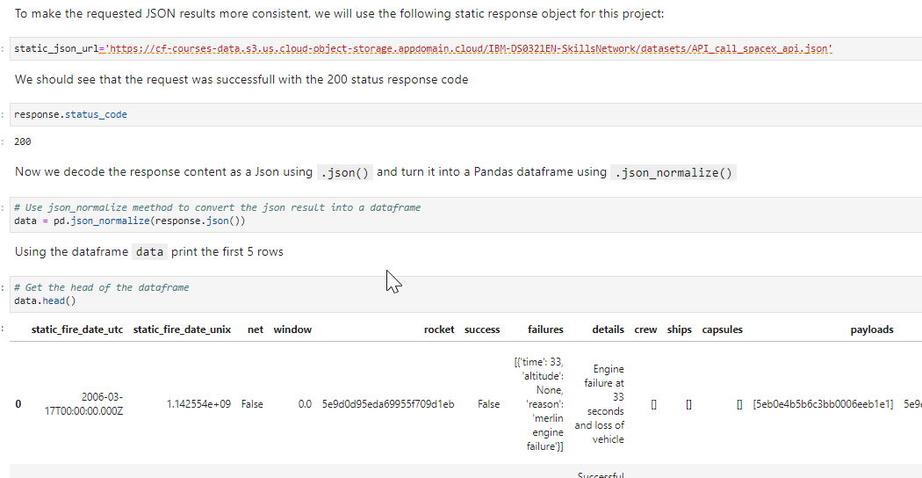
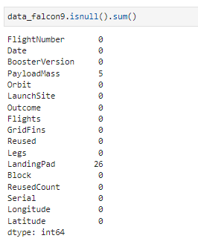
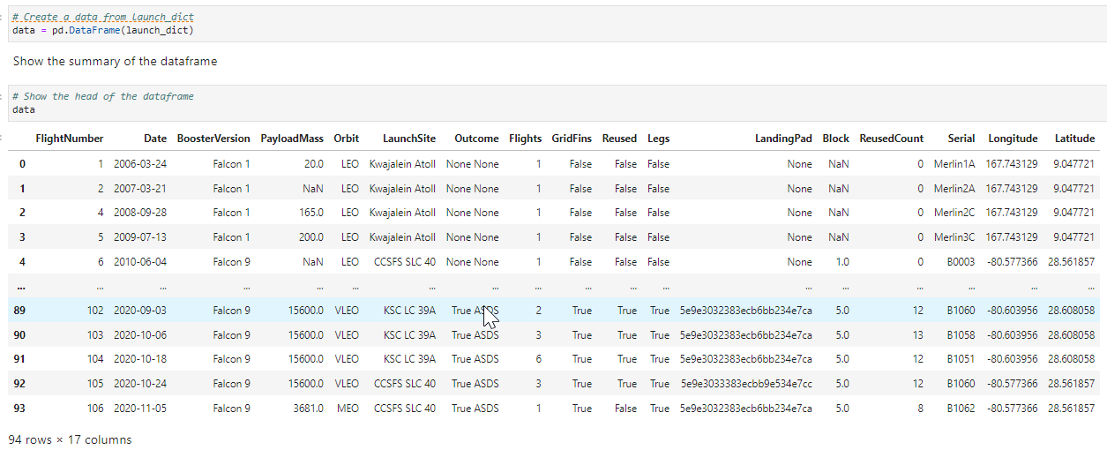
Data Collection – SpaceX API
We get SpaceX launch Data we then turn it into Json finle using Pandas dataframe we then changed ID to a more usable ID example Rocket or other aspects in Column
Then we constructed our data that we combined ID with directory to then choose our specif rocket we wanted to evaluate Falcon 9 and replaced mean for payload and non for missing data
https://github.com/elanLget/testrepo/blob/main/DataVisulization.py
Place your flowchart of SpaceX API calls here

Slide 9
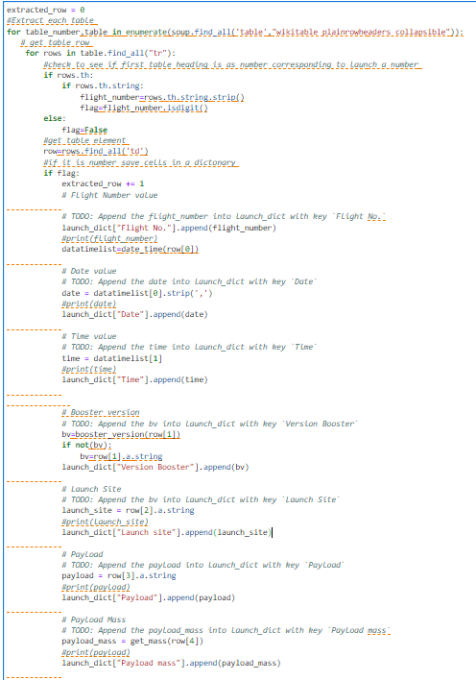
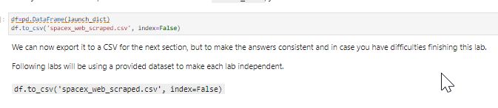
Data Collection - Scraping
The web scraping process using beautifulsoup4
Pulled in data then we defined the different columsn and imported them with an array for relevant columns
Finaly parsed the data to tables and created it into CSV file
Place your flowchart of web scraping here

Slide 10
Data Wrangling
Describe how data were processed
We started data wrangling with figuring out how many launches
launches = df['LaunchSite'].value_counts()
launches
Then the different types of orbits and broke it down to success of each one as well as landing outcome
landing_class= df['landing_class']
df[['landing_class']].head(8)
Than take the mean
https://github.com/elanLget/testrepo/blob/main/DataWrangling.py

Slide 11
EDA with Data Visualization
We graphed success by launch site then we do launch site by payload to correlate between the most successful sites by payload to success as well locations
https://github.com/elanLget/testrepo/blob/main/DataVisulization.py

Slide 12
EDA with SQL
We started with getting the data and separating data into different sites
Then we figured out avg payload mass
Then we separated data into successful landing
Then we started matching payload to boosters
Then match date and correlated to success rate just like payload
https://github.com/elanLget/testrepo/blob/main/SQL.py

Slide 13
Build an Interactive Map with Folium
we wanted to mark all 4 launch sites on map
The we would mark them on map with ability to have
Explain why you added those objects of getting success rates for each location
As well as making a circle around location
Add the GitHub URL of your completed interactive map with Folium map, as an external reference and peer-review purpose

Slide 14
Build a Dashboard with Plotly Dash
Summarize what plots/graphs and interactions you have added to a dashboard
Explain why you added those plots and interactions as well as 100 radius red cirle making easier to fin don map
Finaly get distance from launch site to local water front
https://github.com/elanLget/testrepo/blob/main/Folium.py

Slide 15
Predictive Analysis (Classification)
So we went through several iterations we want to make sure that we are improving over time since if just took average across years like stated earlier 66% but when you adjust for time you see in 2013 when started success was 30% and 2020 went between 80-90% success rate
We used both catplot for dots as well as line plot
https://github.com/elanLget/testrepo/blob/main/PreparingData.py

Slide 16
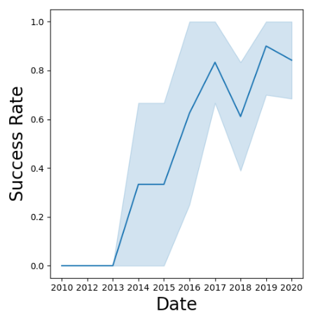
Results
So from doing line plot for success rate and time we get
Interactive analytics demo in screenshots to the right
So even though we avg results give you something doesn’t really show you how they progressed like current picture does

Slide 17

Section 2

Slide 18
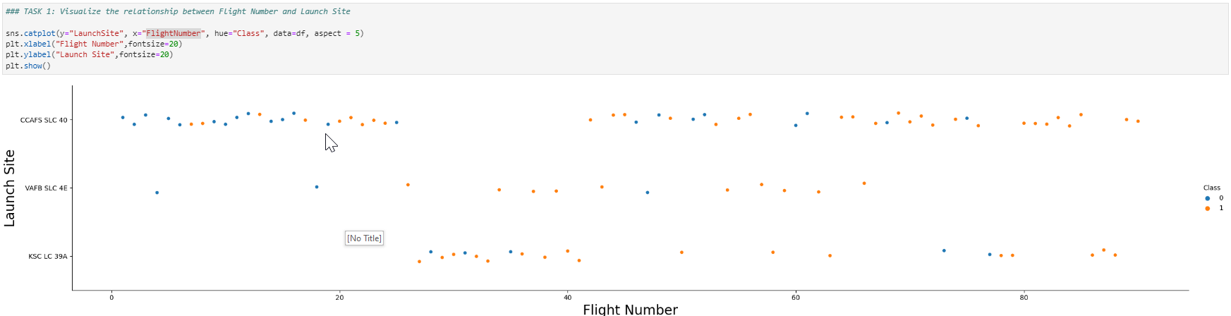
Flight Number vs. Launch Site
Show a scatter plot of Flight Number vs. Launch Site
This shows us above the success rate based of sit to flight number and success goes up as move to right

Slide 19
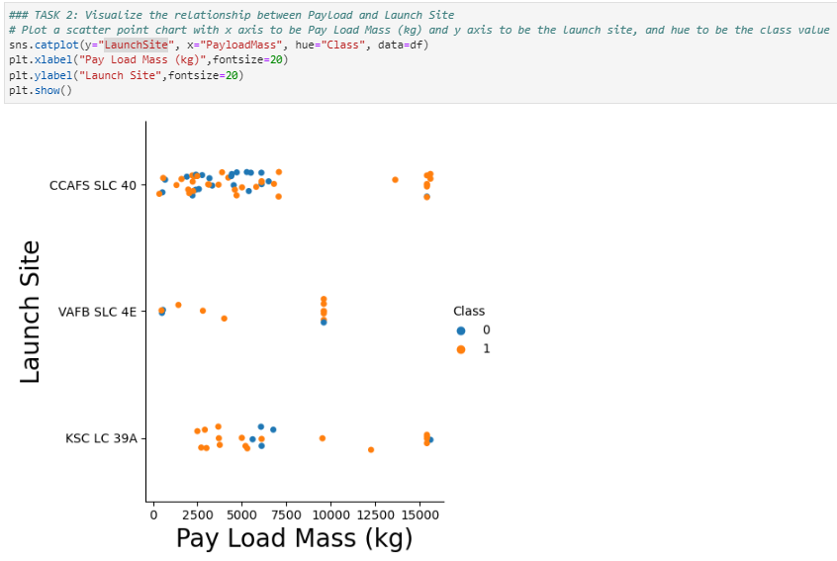
Payload vs. Launch Site
Showing a scatter plot of Payload vs. Launch Site to the right
This scatter plot is showing as we started going to heavier payload success went up but its correlation not cause

Slide 20
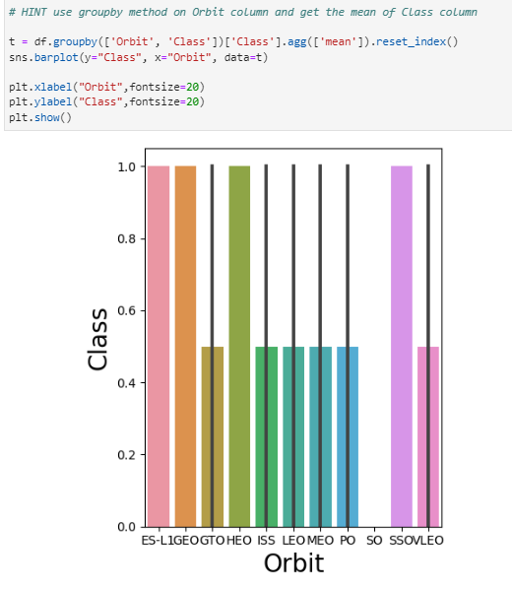
Success Rate vs. Orbit Type
Show a bar chart for the success rate of each orbit type on the right most
To the left shows scatter plot with success rate which shows highest success in 4 categories which on right most bar shows full 1.0 success for class

Slide 21
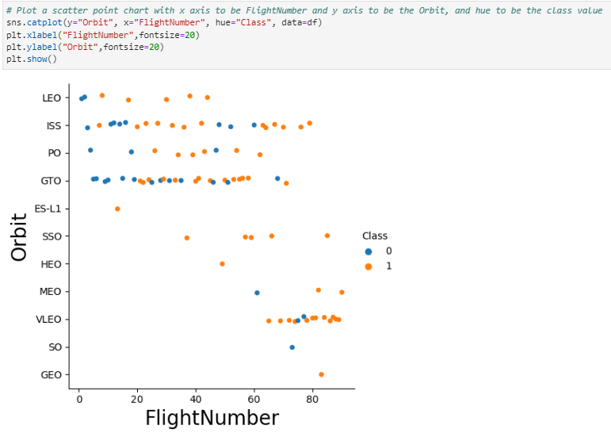
Flight Number vs. Orbit Type
Show a scatter point of Flight number vs. Orbit type
Through this you can see the orange dots and blue for failures for the highest success rates and that towards end VLEO for satellites more towards end with good rate success

Slide 22
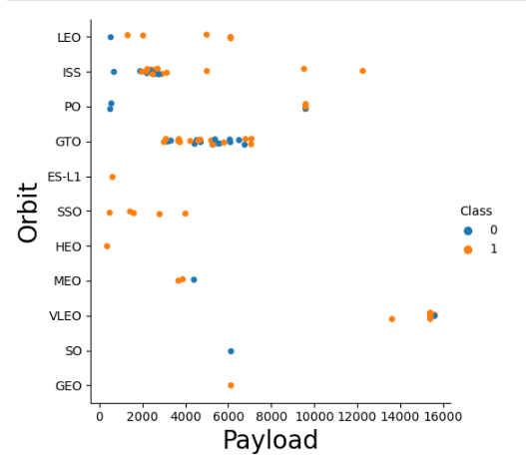
Payload vs. Orbit Type
Show a scatter point of payload vs. orbit type
This shows the very high payload for VLEO since its one of the lower orbits so its less fuel and also that range where you would be sending off satellites

Slide 23
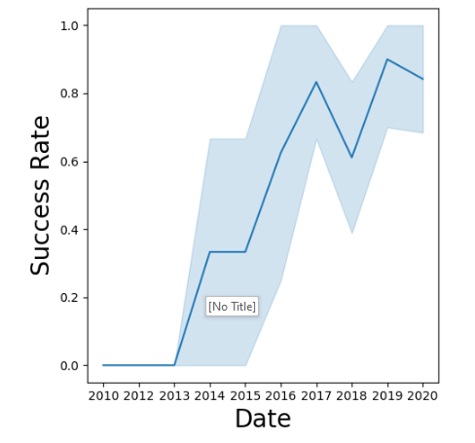
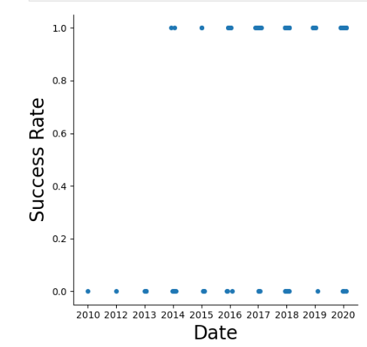
Launch Success Yearly Trend
Show a line chart of yearly average success rate
Show the screenshot of the scatter plot its easier to tell from line plot but the success rate per year is increasing from start at 2013 at 30% to a 80% success in 2020

Slide 24
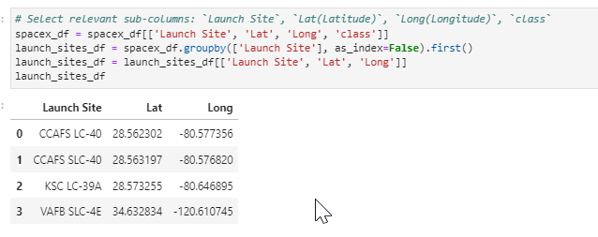
All Launch Site Names
The launch sites are as Fallows CCAFS-LC-40, CCAFS SLC-40, KSC LC-39A, and VAFB SLC-4E
Present your there are 4 major sites used to test rockets

Slide 25
Launch Site Names Begin with 'CCA'
Find 5 records where launch sites begin with `CCA`
Present your query result with a short explanation here

Slide 26
Total Payload Mass
Calculate the total payload carried by boosters from NASA
Present your query result with a short explanation here

Slide 27
Average Payload Mass by F9 v1.1
Calculate the average payload mass carried by booster version F9 v1.1
Present your query result with a short explanation here

Slide 28
First Successful Ground Landing Date
Find the dates of the first successful landing outcome on ground pad
Present your query result with a short explanation here

Slide 29
Successful Drone Ship Landing with Payload between 4000 and 6000
List the names of boosters which have successfully landed on drone ship and had payload mass greater than 4000 but less than 6000
Present your query result with a short explanation here

Slide 30
Total Number of Successful and Failure Mission Outcomes
Calculate the total number of successful and failure mission outcomes
Present your query result with a short explanation here

Slide 31
Boosters Carried Maximum Payload
List the names of the booster which have carried the maximum payload mass
Present your query result with a short explanation here

Slide 32
2015 Launch Records
List the failed landing_outcomes in drone ship, their booster versions, and launch site names for in year 2015
Present your query result with a short explanation here

Slide 33
Rank Landing Outcomes Between 2010-06-04 and 2017-03-20
Rank the count of landing outcomes (such as Failure (drone ship) or Success (ground pad)) between the date 2010-06-04 and 2017-03-20, in descending order
Present your query result with a short explanation here

Slide 34

Section 3

Slide 35
<Folium Map Screenshot 1>
Replace <Folium map screenshot 1> title with an appropriate title
Explore the generated folium map and make a proper screenshot to include all launch sites’ location markers on a global map
Explain the important elements and findings on the screenshot

Slide 36
<Folium Map Screenshot 2>
Replace <Folium map screenshot 2> title with an appropriate title
Explore the folium map and make a proper screenshot to show the color-labeled launch outcomes on the map
Explain the important elements and findings on the screenshot

Slide 37
<Folium Map Screenshot 3>
Replace <Folium map screenshot 3> title with an appropriate title
Explore the generated folium map and show the screenshot of a selected launch site to its proximities such as railway, highway, coastline, with distance calculated and displayed
Explain the important elements and findings on the screenshot

Slide 38

Section 4

Slide 39
<Dashboard Screenshot 1>
Replace <Dashboard screenshot 1> title with an appropriate title
Show the screenshot of launch success count for all sites, in a piechart
Explain the important elements and findings on the screenshot

Slide 40
<Dashboard Screenshot 2>
Replace <Dashboard screenshot 2> title with an appropriate title
Show the screenshot of the piechart for the launch site with highest launch success ratio
Explain the important elements and findings on the screenshot

Slide 41
<Dashboard Screenshot 3>
Replace <Dashboard screenshot 3> title with an appropriate title
Show screenshots of Payload vs. Launch Outcome scatter plot for all sites, with different payload selected in the range slider
Explain the important elements and findings on the screenshot, such as which payload range or booster version have the largest success rate, etc.

Slide 42

Section 5

Slide 43
Classification Accuracy
Visualize the built model accuracy for all built classification models, in a bar chart
Find which model has the highest classification accuracy

Slide 44
Confusion Matrix
Show the confusion matrix of the best performing model with an explanation

Slide 45
Conclusions
Point 1
Point 2
Point 3
Point 4
…

Slide 46
Appendix
Include any relevant assets like Python code snippets, SQL queries, charts, Notebook outputs, or data sets that you may have created during this project

Slide 47


